Slide 1
Ho Chi Minh University of Science
Predict HIV Progression
Team BETA

Slide 2
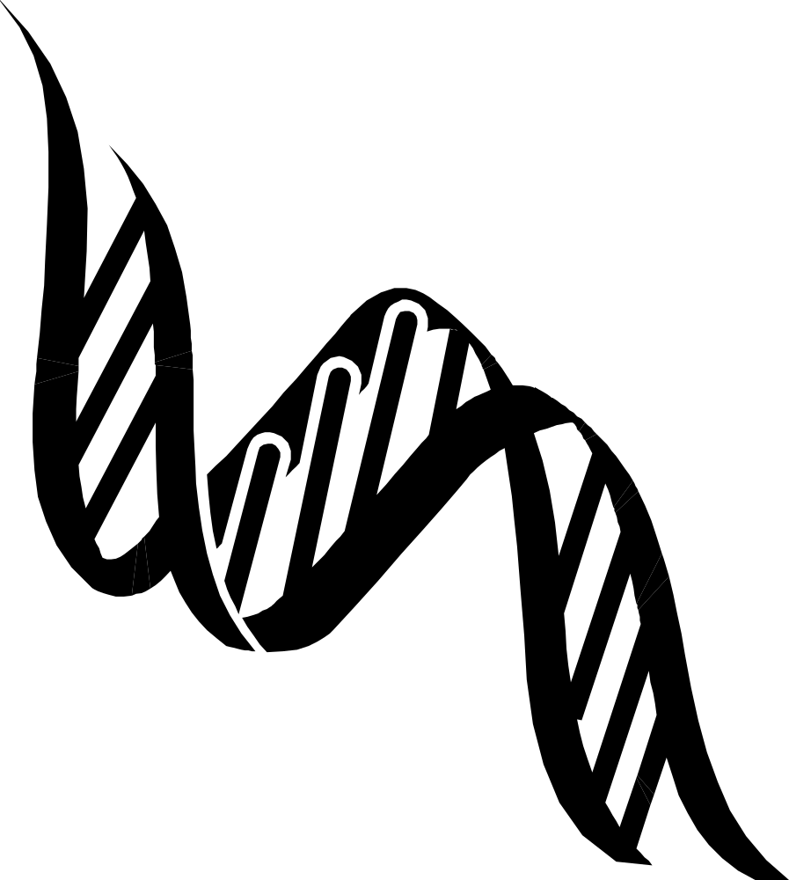

Slide 3
Input
Protease nucleotide
Reverse Transcriptase nucleotide
Viral load at the beginning of therapy
CD4 count at the beginning of therapy

Slide 4
Output
Predict whether the patient improved after therapy or not.
*Improvement is defined as a 100-fold decrease in the HIV-1 viral load.

Slide 5
- A Big Data problem
- 1692 patients ~ 676800 nucleotides*
- Using Machine Learning to solve
- No biological knowledge needed
- Minimal infection
- Save cost $5000 / patient / year
*Data trusted from World Health Organization

Slide 6
95% correct

Slide 7
Demonstrate and Q&A
We are from
Ho Chi Minh University of Science.
Thank you!

